Slide 1
MGT388 Finance for Engineers
Lecture 5:
Marginal costing and short-term decision making

Slide 2
Lecture Outline
Relevant costs for decision making in the short-term
Cost behaviour patters
Marginal costing
Short-term decisions: Accept or reject special orders
Closing a product line
Make or buy decisions

Slide 3
Relevant costs for decision making
Relevant costs and revenues are those costs and revenues that will differ for each option available to the decision maker.
Sunk costs are past costs.
As these have already been incurred, they are irrelevant to a decision.
Future costs and revenues that change under the different options are relevant costs.

Slide 4
Relevant costs for decision making
Opportunity costs are relevant.
This is the value of the benefit sacrificed when one course of action is chosen in preference to an alternative.
e.g. study/work

Slide 5
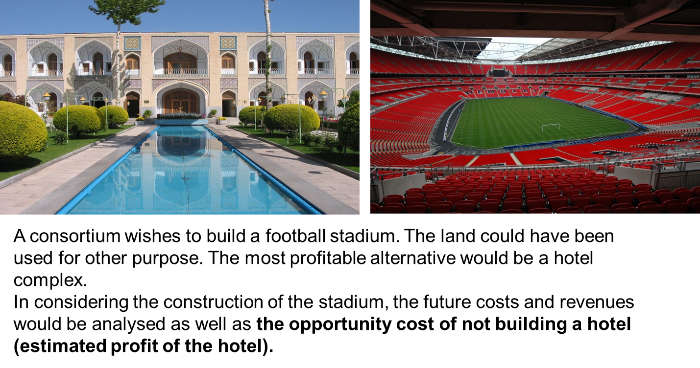
Relevant costs for decision making

Slide 6
Cost behaviour patterns
Costs
Variable Costs
Fixed Costs
Semi - Variable Costs
Semi - Fixed Costs

Slide 7
Cost behaviour patterns
Assume that Royal Bicycles buys a handlebar at €52 for each of its bicycles. What is the total handlebar cost when:
1) 1,000; 2) 3,500 bicycles are assembled?
€182,000
€52,000
0 1,000 3,500 Units
Total variable costs
Variable cost per unit is fixed: €52 per unit
However, total variable cost changes

Slide 8
Cost behaviour patterns
Variable cost per unit
Variable
cost
per unit
€52
0 1 2 ... 1,000 ... 3,500 Units
Variable cost per unit is fixed: €52 per unit
However, total variable cost changes

Slide 9
Cost behaviour patterns
Assume that Royal Bicycles incurred €94,500 in a given year for the leasing of its plant.
These costs are unchanged in total over a designated range of the number of bicycles assembled during a given time period.
What is the leasing cost per bicycle when Royal assembles 1) 1,000; and, 2) 3,500 bicycles?
1) €94,500 ÷ 1,000 = €94.50
2) €94,500 ÷ 3,500 = €27.00.

Slide 10
Cost behaviour patterns
Total Fixed Cost
Total fixed cost is fixed: €94,500
However, Fixed cost per unit changes
Total Fixed
costs
€ 94,500
0 1 2 ... 1,000 ... 3,500 Units

Slide 11
Cost behaviour patterns
Fixed cost per unit
Fixed cost
per unit
€94.5
€27
0 1,000 3,500 Units
Total fixed cost is fixed: €94,500
However, Fixed cost per unit changes

Slide 12
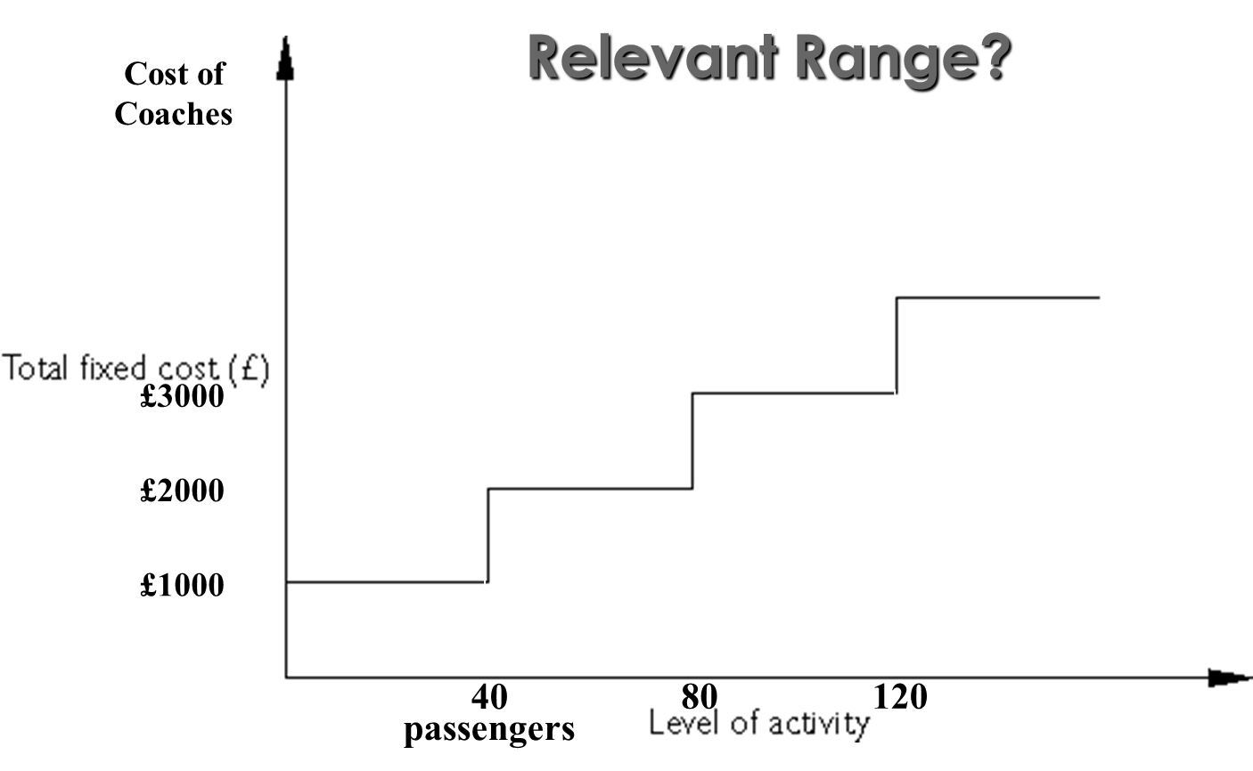
Cost behaviour patterns

Slide 13
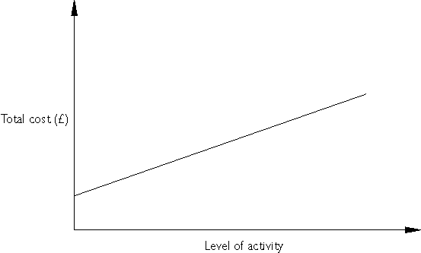
Cost behaviour patterns
Total Telephone charges
Fixed fee

Slide 14
Marginal costing
Marginal cost is the cost of one additional unit of a product or service. The cost of an additional unit is the cost that change.
Variable costs are the costs that change and so are considered in marginal costing.
Fixed costs do not change if just one extra unit is produced, so they are not considered in marginal costing.

Slide 15
Marginal costing
Contribution only considers the costs and revenues that will change.
Contribution margin = Sales revenue – Variable costs
In the short term a project will be accepted if it makes a positive contribution.
That is, it contributes to fixed costs and profit of a business.
Operating profit = Contribution margin – Fixed costs

Slide 16
Acceptance/rejection of a special order
Hi Co. is currently selling its product at £40 per unit.
It has received a special order for 100 units at £30 each.
Its variable cost is £25 per unit. Should this order be accepted?

Slide 17
Acceptance/rejection of a special order
Solution:
Sales 100 x £30 = £3,000
Less: VC 100 x £25 = £2,500
Contribution £5 £500
Yes, the special order should be accepted on financial grounds because it generates a positive contribution.

Slide 18
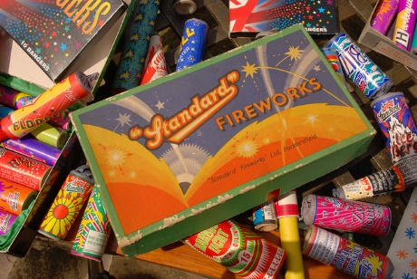

Acceptance/rejection of a special order
Firelight Ltd manufactures boxes of fireworks.
Each box of fireworks sells for £120.
Variable cost per box is £35.
Fixed overheads amount to £60,000.
1,000 boxes of fireworks are produced but there is capacity to produce 1,300 boxes.
Firelight Ltd receives a special order for to supply 200 boxes of fireworks for £40.
Should Firelight Ltd accept the order?

Slide 19
Acceptance/rejection of a special order
Profit prior to the special order:
Sales Revenue (£120 x 1,000) 120,000
Variable costs (£35 x 1,000) (35,000)
Fixed costs (60,000)
Profit 25,000

Slide 20
Acceptance/rejection of a special order
Using marginal costing, the order will be accepted if contribution margin is positive.
Sales value – variable cost = contribution margin
£40- £35 = £5
Therefore, the special order should be accepted.

Slide 21
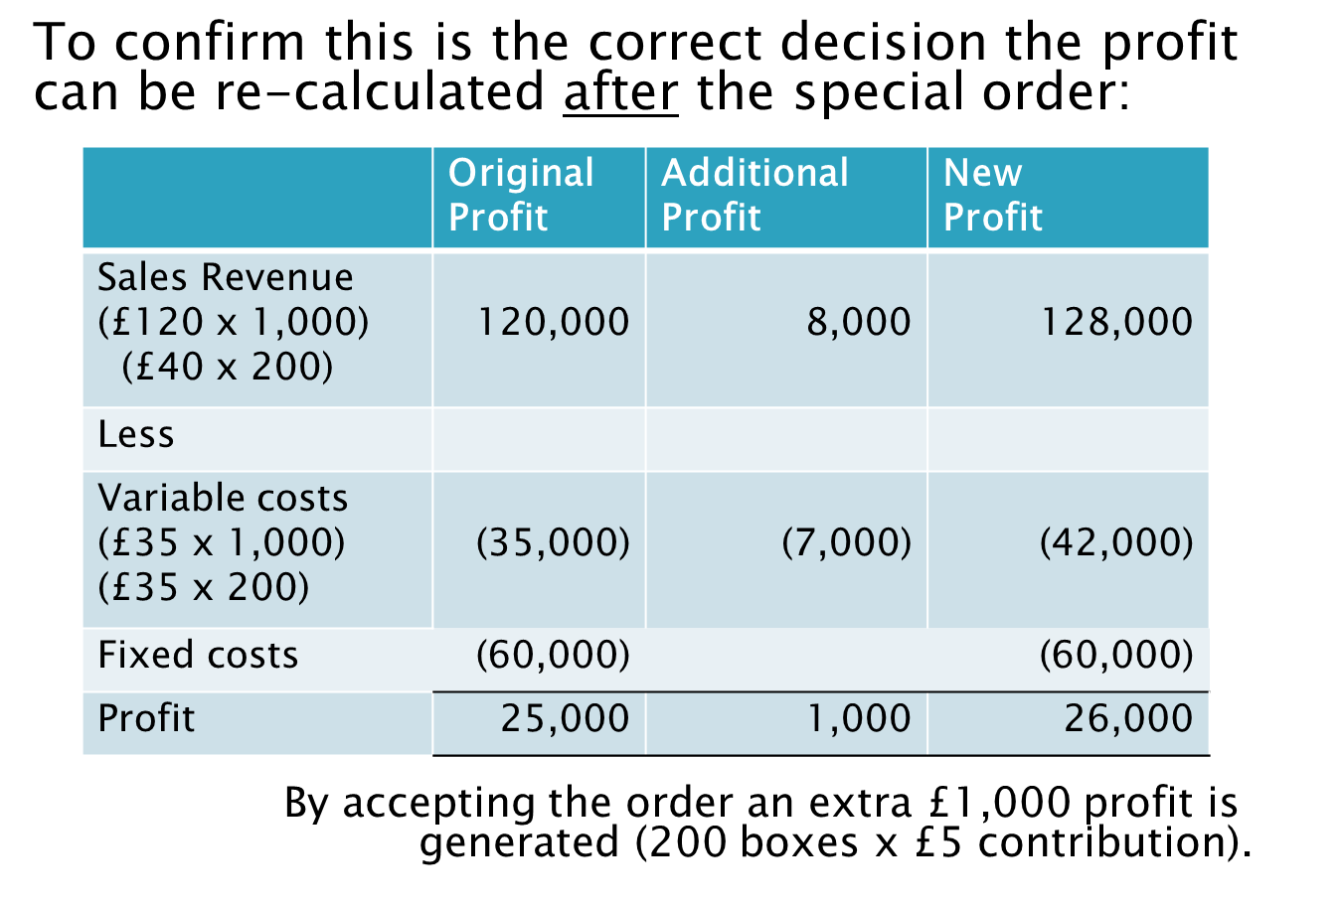
Acceptance/rejection of a special order

Slide 22
Acceptance/rejection of a special order
Would the correct decision be made using product costing/absorption costing?
Variable costs are £35. Fixed costs are £60,000.
If we accept the order, units of production are 1,200 boxes.
Under absorption costing each box would be apportioned £60,000/1,200 = £50
The total cost of £85 (£35+£50) would be compared to a sales price (£40). As the sales price is £40, the order would not be accepted, and additional profit would be foregone.

Slide 23
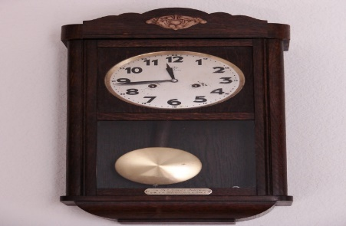

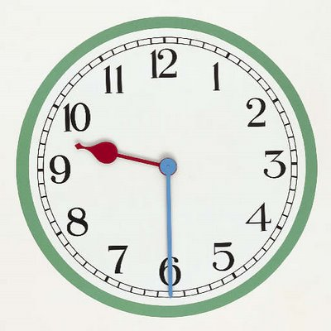
Discontinue production
Time Ltd manufactures 3 styles of wall clock: classic, contemporary and modern.
For the current period 9,000 of each style of clock is produced.
Sales value per unit is £50 (classic), £55 (contemporary), and £ 80 (modern).
Variable cost per unit is £20 (classic), £40 (contemporary), and £45 (modern).
Fixed costs of £435,000 are apportioned equally to each product line.

Slide 24
Discontinue production
It appears that the contemporary range are loss making and Time Ltd plans to discontinue production.
State whether this decision is correct if:
(a) No alternative use for the facilities used in making the contemporary clocks.
(b) The facilities could be used to make a further 4,000 modern clocks.

Slide 25
Discontinue production
 | Classic £ | Contemporary £ | Modern £ | Total £
Sales value | 50 | 55 | 80
Variable cost | (20) | (40) | (45)
Contribution per unit | 30 | 15 | 35
N. of units | 9,000 | 9,000 | 9,000
Total contribution | 270,000 | 135,000 | 315,000 | 720,000
Fixed costs | (145,000) | (145,000) | (145,000) | (435,000)
Profit/(loss) | 125,000 | (10,000) | 170,000 | 285,000

Slide 26
Discontinue production
 | Classic £ | Contemporary £ | Modern £ | Total £
Total contribution | 270,000 | 135,000 | 315,000 | 720,000
Fixed costs | (145,000) | (145,000) | (145,000) | (435,000)
Profit/(loss) | 125,000 | (10,000) | 170,000 | 285,000
 | Classic £ | Contemporary £ | Modern £ | Total £
Total contribution | 270,000 | 135,000 | 315,000 | 720,000
Fixed costs | (145,000) | (145,000) | (145,000) | (435,000)
Profit/(loss) | 125,000 | (10,000) | 170,000 | 285,000
 | Classic £ | Contemporary £ | Modern £ | Total £
Total contribution | 270,000 | 0 | 315,000 | 585,000
Fixed costs | (217,500) | (0) | (217,500) | (435,000)
Profit/(loss) | 52,500 | 0 | 97,500 | 150,000

Slide 27
Discontinue production
(a) If no other use can be made of the facilities, Time Ltd should continue production of contemporary clocks.
Contemporary clocks had made a positive contribution of £135,000 to fixed costs and profits.
Total profits with contemporary clocks is £285,000. Total profits without contemporary clocks is £150,000.

Slide 28
Discontinue production
(b) However if facilities can be used to produce 4,000 extra modern clocks, the calculation needs to include the opportunity cost of not producing the modern clocks.
The contribution per unit of a modern clock is £35 and 4,000 can be manufactured if contemporary clocks are discontinued.
The opportunity cost of making contemporary clocks is (4,000 x £35) = £140,000.

Slide 29
Discontinue production
£
Sales value of contemporary clocks (55 x 9,000) 495,000
Variable costs of contemp. clocks (40 x 9,000) (360,000)
Contribution of contemporary clocks 135,000
Opportunity cost (contribution modern clocks) (140,000)
Revised contribution (5,000)
As revised contribution is negative, Time Ltd should stop production of contemporary clocks and switch to modern clocks.

Slide 30

Make-or-buy
Where a component can be manufactured or bought, a business must decide which will be more profitable.
If there is surplus capacity, then variable costs of manufacture should be compared with purchase price.

Slide 31

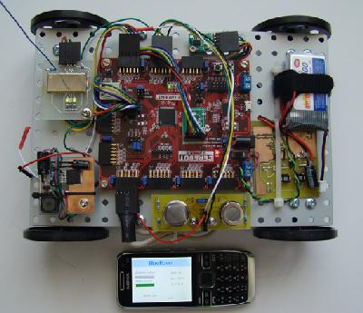
Make-or-buy
The circuit board has variable cost of £300 and allocated fixed overheads of £100.
If the circuit board can be bought, it would cost the company £350.
Should the production of the circuit board be outsourced?
Variable cost is lower than purchasing price, so “make” is better than “buy”, if there is surplus capacity. Decision: no outsourcing.

Slide 32
Reading (optional)
Gowthorpe: Chapter 14

